Slide 1
Become a ALM in Microsoft Office 365 App Development Ninja. Enter into the ALM for Office 365 Dojo!
Tiago Costa – MVP, MCT
Notes:
This slide is mandatory. Please do not remove.

Slide 2



Tiago Costa
IT Consultant, Trainer, Author and Speaker
Independent Contractor
http://www.tiagocosta.eu/
@tiagocostapt
MVP, MCT, MCT Regional Lead

Slide 3
Agenda

Slide 4
Agenda
Office 365 Momentum!
Demo: Automated builds for Add-Ins (Azure)
Managing dev/test/prod for apps in Azure
Demo: Using Azure deployment slots for dev/test/prod environments

Slide 5
Office 365 Momentum!

Slide 6

Office 365 Developer momentum!
"The most strategic developer surface area for us is Office 365“ - Satya Nadella

Slide 7
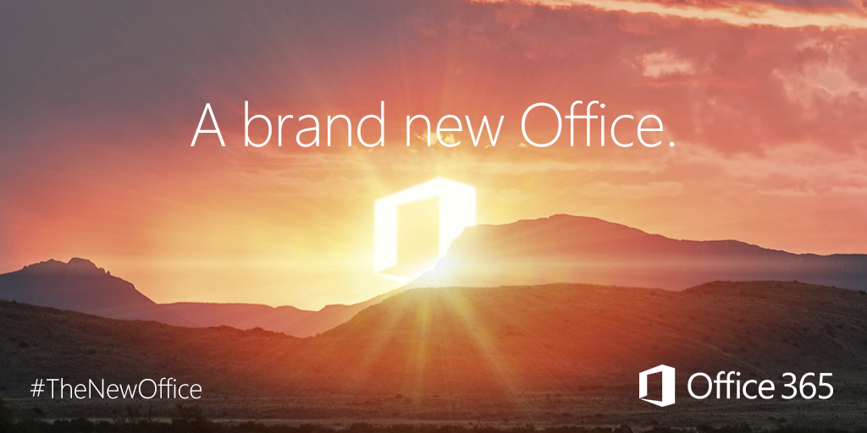
Office 365 Subscribers
20.6 million subscribers
http://microsoft-news.com/office-365-now-has-20-6-million-subscribers/

Slide 8
What do we mean by ALM?
ALM focuses on:
Efficient team development, with quality outputs
Planning for application upgrades
Predictable deployments
Like:
Continuous Integration / Continuous Deployment
Packages not build on dev machines
Code quality checks
Structured deployment process

Slide 9
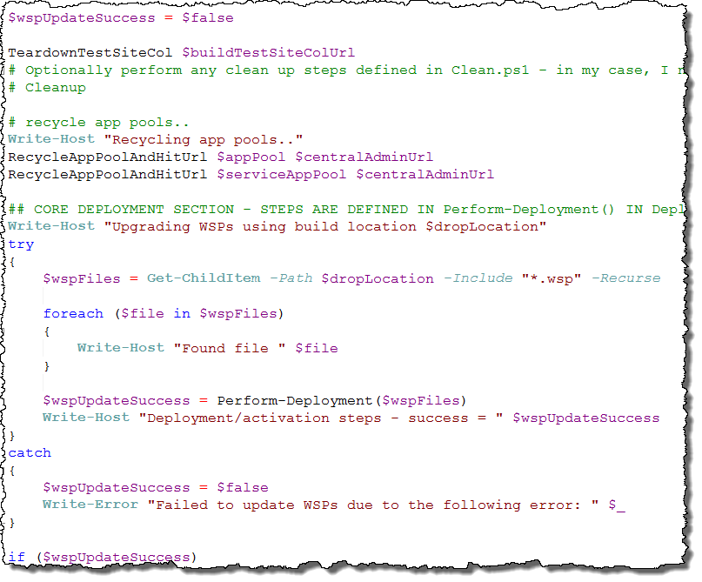
SharePoint + ALM = Pain ???
Needed:
On-premises TFS Server
On-premises SharePoint VM to deploy to
Customization of build process
PowerShell remoting
Lots of custom PS scripts – http://sharepointci.codeplex.com

Slide 10
Good News!!!
ALM for ASP.Net App is MUCH easier!
☺

Slide 11
Flavours of App Development
Type
Office 365 app
SharePoint Add-In / Office Add-In
Hosting
Azure
Other Cloud
On-prem IIS Servers
Worth considering Azure for ALM in Dev phase, even if not real target.

Slide 12
Continuous Deployment with Azure and Team Services
Developer Checks-in
Build runs on hosted build controller
Output automatically deployed to Azure Web App

Slide 13
Demo
Automated builds for Add-Ins (Azure)

Slide 14
ALM Process
Auto-deployment
App Updated in Azure
Check-In

Slide 15
CD – Azure and Team Services (Summary)
Configure project for Office 365 Integration
App registered in AAD - Azure Active Directory
Add Solution to source control
Create Azure Web App, Select “publish from source control”

Slide 16
Microsoft Azure: Old vs New Portal
Some feature not in both Portals
New features go into the New Portal
Some features only in old Portal
Ex: AAD: Azure Active Directory

Slide 17
Managing dev/test/prod for apps in Azure

Slide 18
Multiple Office 365 tenants
Using multiple Office 365 tenancies? Apps in Azure have some considerations! *
* Specifically Office 365 apps
Apps which use the Office 365 Unified API
Apps which use Azure AD Auth (for SSO)

Slide 19
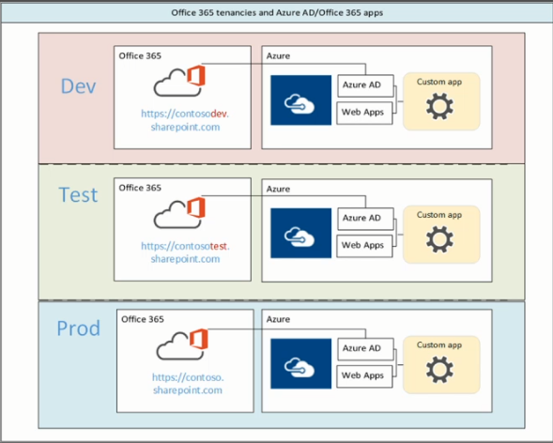
The issue
Office 365 apps need to be registered in the “correct” Azure AD (tied to Office 365 tenancy)
App needs to be registered / deployed to EACH Azure subscription behind your tenancies

Slide 20
DEV/test/UAT/prod for apps in Azure - Issue
Usually “Test” Office 365 tenancies do not have:
Domain integration (e.g. ourCompany.com nor something.onmicrosoft.com
Full directory of real users
AAD Sync
Yammer Enterprise
Production license type (E3 / E5)
…

Slide 21
The Answer?
Azure Deployment Slots!

Slide 22
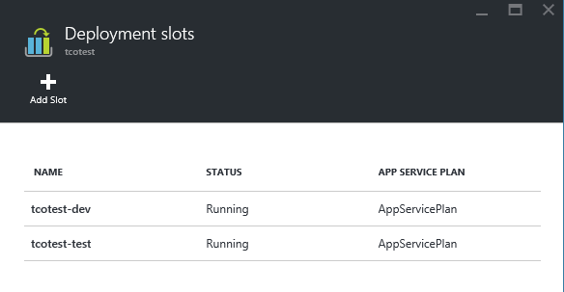
Azure Web Apps – Deployment Slots
Defines Additional “Instances” of an Azure Web App
Allow you to test purely in production Office 365 environment, but with dev/test/prod separation for apps (Azure Web Apps)

Slide 23
Azure Web Apps – Deployment Slots
Each Web App:
Different URL (With Slot name)
Own app settings
Own connection strings
Own SCM site
http://mysite.azurewebsites.net
http://mysite-dev.azurewebsites.net
http://mysite-test.azurewebsites.net

Slide 24
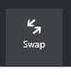
Swapping deployment slots
Slots can be swapped to deploy updates
Actually a DNS update, not a copy of content
Process
Publish updates to dev/test slots
Swap test/production when ready
In Azure Portal
PowerShell
Switch-AzureWebsiteSlot

Slide 25
Demo
Using Azure deployment slots for dev/test/prod environments

Slide 26
Summary – Using deployment slots for apps
Create additional deployment slots
Register separate instance of app in Azure AD
Configure “Slot-specific” ida:ClientId and ida:ClientSecret
Deploy app to slot

Slide 27
Update process using slots
Continuous build deploys to DEV slot
When ready, swap DEV and TEST
Once testing is completed (and no rollback needed), then manually publish same build to DEV slot
Now DEV and TEST are the same, but PROD is not
When ready, swap TEST and PROD
Once testing is completed (and to rollback needed), then swap DEV and TEST, and manually publish same build to DEV slot
Now updates in PROD and all slots are the same.

Slide 28
Summary
Never done automated builds before? NOW is the time!!!
App development models mean SharePoint complexities are removed
Team Services can provide build mechanism
Azure can provide the deployment and hosting mechanism

Slide 29
Q & A

Slide 30
Notes:
This slide is mandatory. Please do not remove and try to use it during Q&A at the end of your session. Thank you!

Slide 31
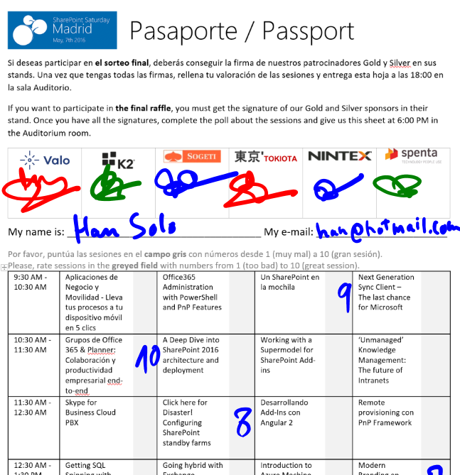
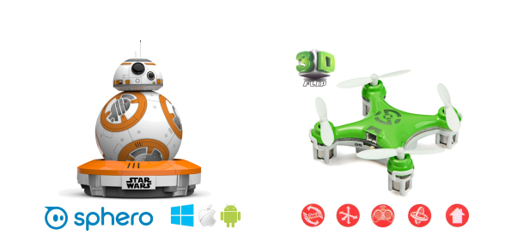
Raffle
Please, fill your SPS Madrid passport if you want to participate.
You must get signature from sponsors and complete the poll.
Give us the passport at 6:00 PM in the Auditorium room.
You can win one Sphero BB-8 or a mini drone:

